Slide 1
used cars price prediction price in Saudi Arabia regression models
Presented by/ Jamilah Rabeh
Supervised by/Dr.mejdel Alqahtani

Slide 2
Abstract
Our project aimed to applied regression model to predict price of the used cars in Saudi Arabia
This project may help people to have a clear vision about use car prices and what the main factors that has a higher influence
I used web scraping to obtain data from syarah web site (web scraping and selenium)
I applied nonlinear regression (polynomial regression)
I applied four models to reach to the best score of error

Slide 3
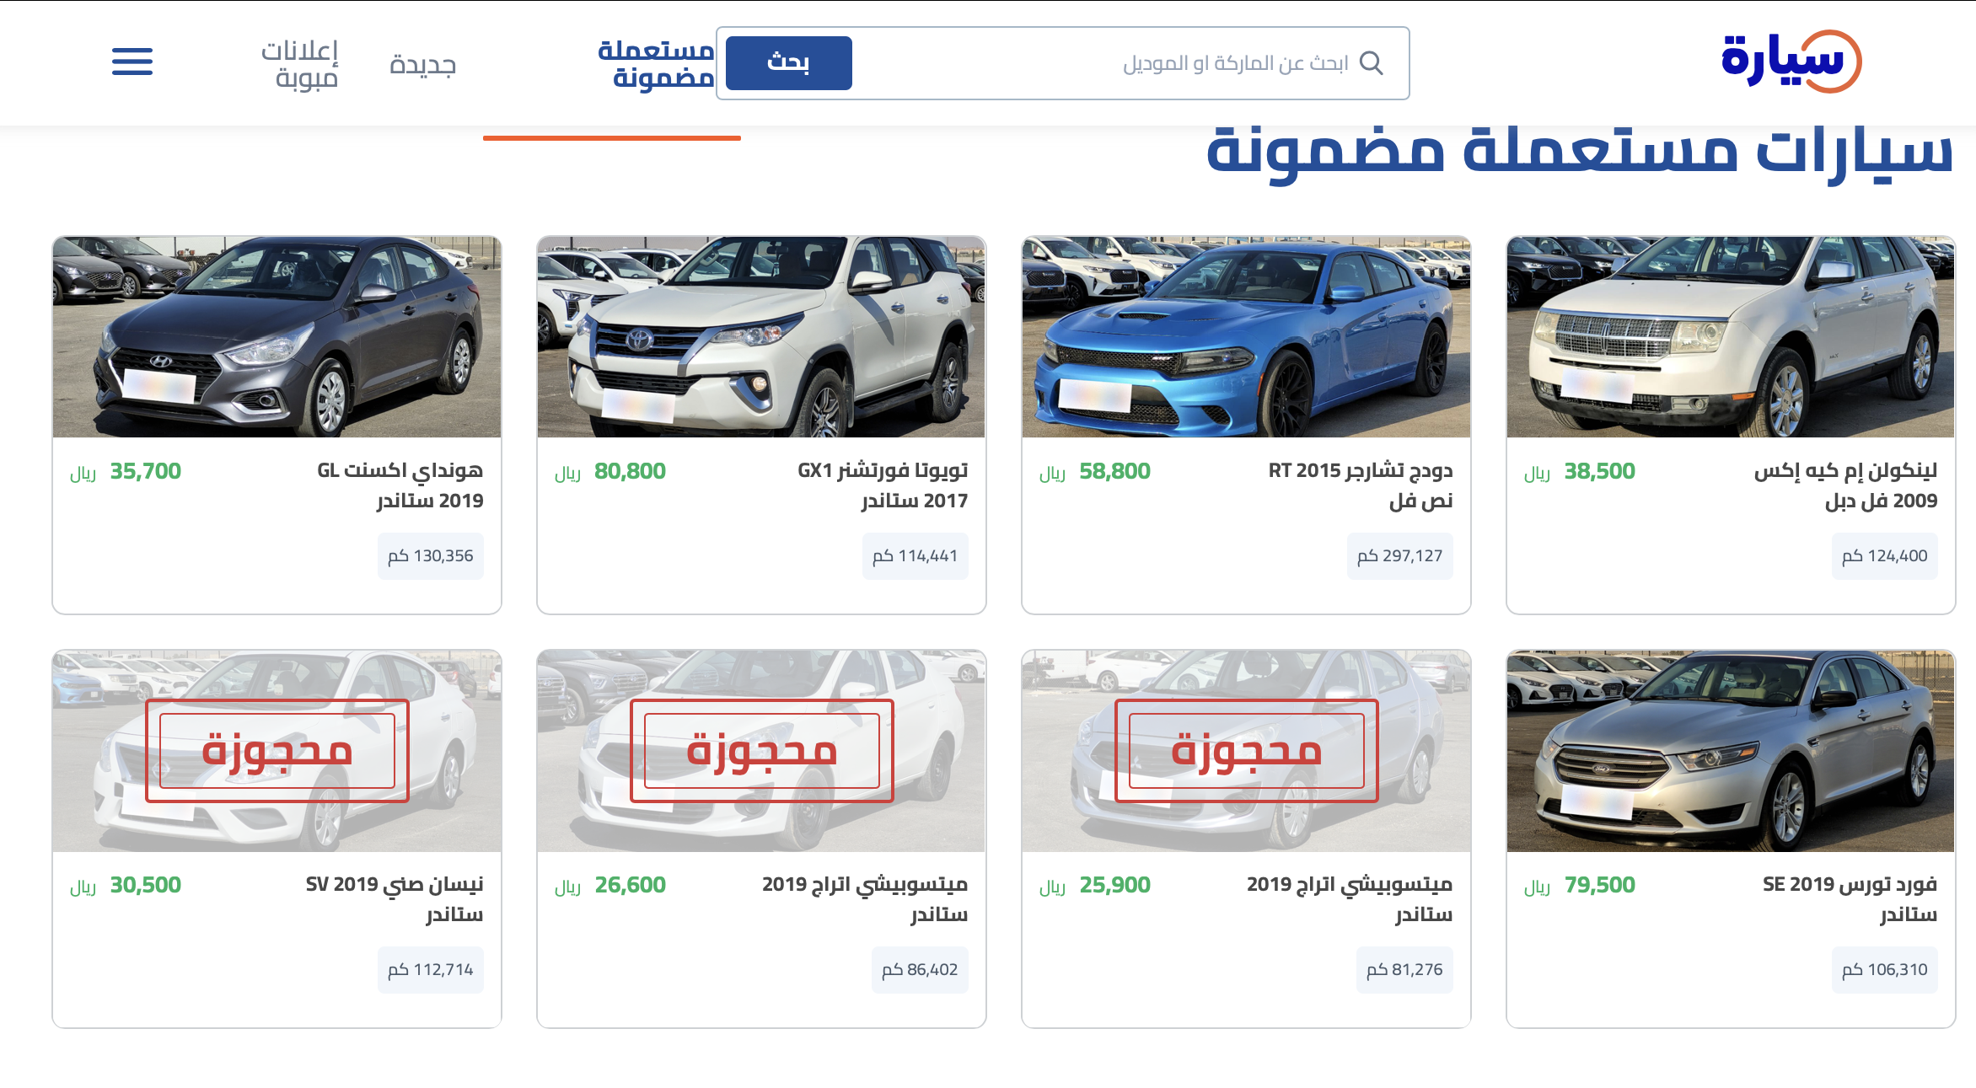
Data
Features
Car name
Model
Mileage
Engine size
Options
Fuel type
Regions
Origin
color
price
DS=8765X10

Slide 4
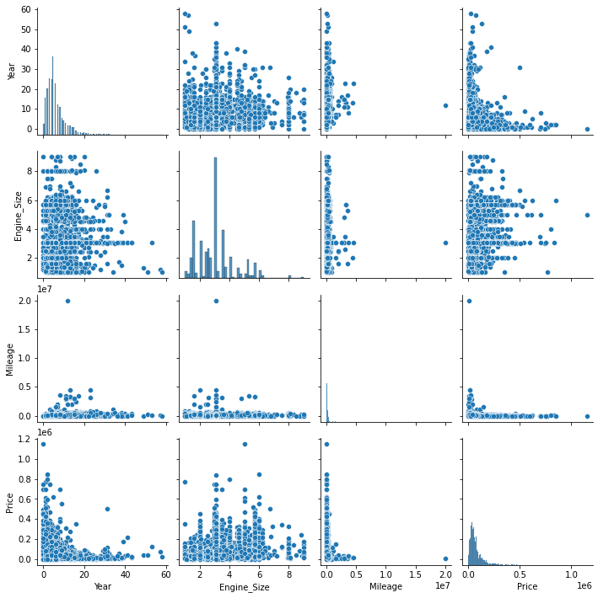
EDA
visualized distribution and correlation of features
handling missing values and outlier
IQR
skewness value of Price: 3.6917 after 0.8908
skewness value of Mileage: 39.755 after 0.97886
skewness value of Engine Size: 1.0074
detect multicollinearity by Variance Inflation Factor
feature VIF
Year 2.841255
Mileage 2.815823
Engine_Size 2.741316
Generated ‘car age column’ and ‘fuel economy’
Label encoding for categorical columns
Std scaling

Slide 5
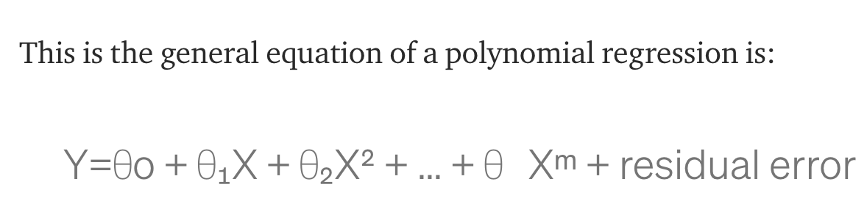
Polynomial regression equation

Slide 6
Model 1
Model 2
Polynomial feature D=2 , column= 263 ,alph=0.1
Polynomial feature D=3, column= 3654 ,alph=0.2
R^2 train
R^2
test
R^2 train
R^2
test
Linear reg
0.54
0.34
Linear reg
0.64
0.60
lasso
0.58
0.56
lasso
0.76
0.69
Ridge
0.60
0.59
Ridge
0.75
0.71
Required column=207
Required column=501

Slide 7
Model 3
Model 3
Polynomial feature D=3 , column= 3654
Polynomial feature D=4 , column= 27405
R^2 train
R^2
test
R^2 train
R^2
test
Linear reg
0.64
0.45
Linear reg
0.74
0.62
lassoCV
0.78
0.67
lassoCV
0.81
0.78
RidgeCV
0.78
0.72
RidgeCV
0.85
0.83
Required column=645
Required column=645

Slide 8
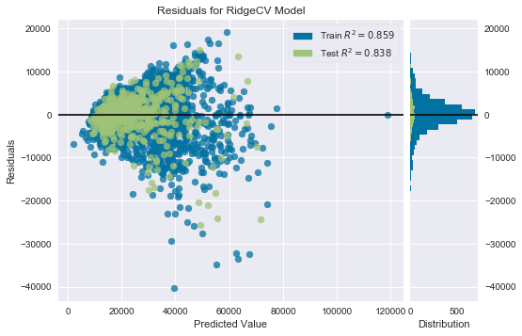
model performance

Slide 9
Conclousion
The model has a good fitting for inexpensive cars
Extract importance feature and retrain model has a good impact on rising R squre
Using LasooCV or RidgeCV may work efficiently rather than tunig hyper parameter by your self
RidgeCV was the best model prediction

Slide 10
Future work
Tunig more hyper prameters
Using Random forcement
Creating more features from esxited features

